Slide 1
Psychiatrist Chat Bot
Backend Team: Enrique Hernandez, Kenny Chhoeun Marcos Herrera, Matthew Chang

Slide 2
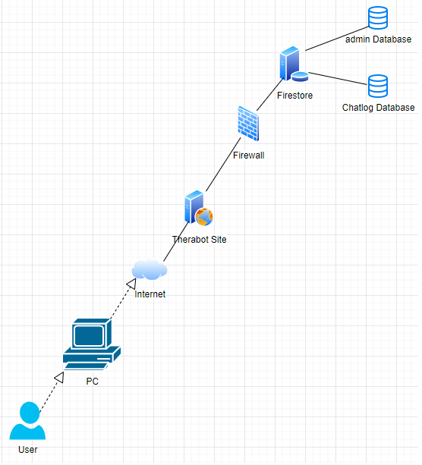
Deployment Diagram

Slide 3
General Logic Flow
After a user creates their account, their credentials are stored in Firestore
Firebase authenticates users logging in
Chat commences, user messages are saved in Firestore for resuming chat later
Users’ messages are analyzed by the bot to ultimately diagnose their emotions
* visualized by the component diagram in next slide

Slide 4
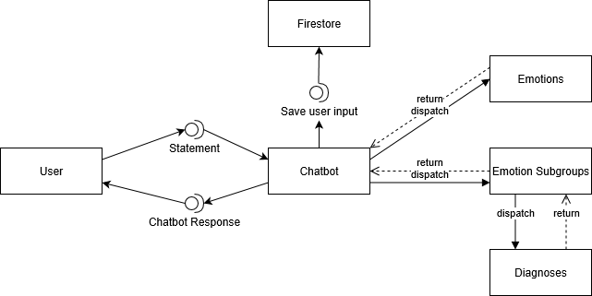
Components

Slide 5
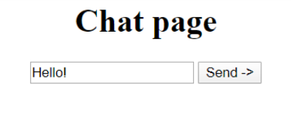
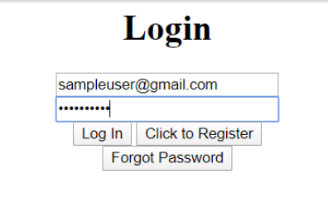
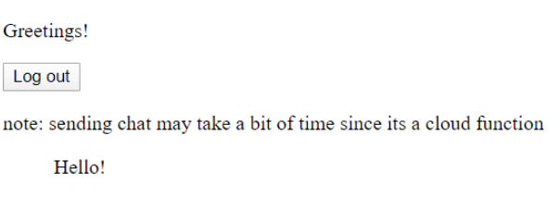
Login & Bot Greeting
Chat Bot Response (not logged, only displayed real-time)
User Response (logged on page & Firebase)

Slide 6
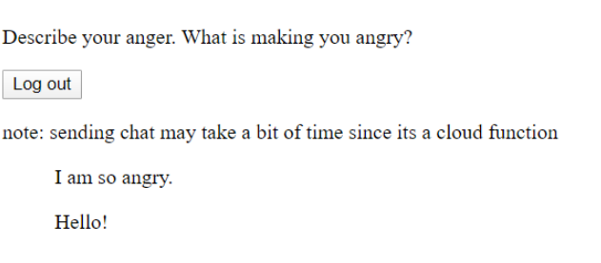
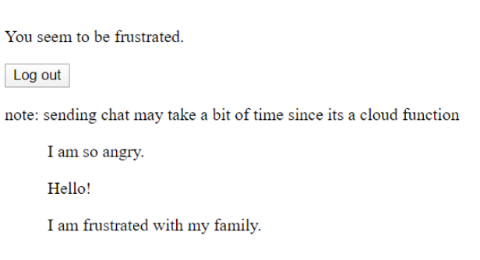




Chat Analysis & Response
Chat bot takes user input and pattern-matches keywords to decide on its response back to the user.

